Slide 1


MACHINE LEARNING

Slide 2
What is a Decision Tree?
A graphical representation of all possible solution to a decision based on certain condition

Slide 3
Understanding Decision Tree
Color | Diameter | Label
Green | 3 | Mango
Yellow | 3 | Mango
Red | 1 | Grape
Red | 1 | Grape
Yellow | 3 | Lemon

Slide 4
d>=3
?
False
True
Red | 1 | Grape
Red | 1 | Grape
Green | 3 | Mango
Yellow | 3 | Mango
Yellow | 3 | Lemon

Slide 5
d>=3
?
False
True
Red | 1 | Grape
Red | 1 | Grape
Green | 3 | Mango
Yellow | 3 | Mango
Yellow | 3 | Lemon
Color is yellow
?
False
True
Green | 3 | Mango
Yellow | 3 | Mango
Yellow | 3 | Lemon

Slide 6
Entropy
S is a sample of training examples
p₊ is the proportion of positive examples
p₋ is the proportion of negative examples
Entropy measures the impurity of S
Entropy(S) = -p₊ log₂ p₊ - p₋ log₂ p₋
If no.of yes=no.of no then E(s)=1
If no.of yes or no.of no is 1 or Zero then E(s)=0

Slide 7
Information Gain
Gain(S,A): expected reduction in entropy due to sorting S on attribute A
Gain(S,A)=Entropy(S) - ∑_{v∈values(A)} |S_{v}|/|S| Entropy(S_{v})

Slide 8
Day | Outlook | Temp | Humidity | Wind | Tennis?
D1 | Sunny | Hot | High | Weak | No
D2 | Sunny | Hot | High | Strong | No
D3 | Overcast | Hot | High | Weak | Yes
D4 | Rain | Mild | High | Weak | Yes
D5 | Rain | Cool | Normal | Weak | Yes
D6 | Rain | Cool | Normal | Strong | No
D7 | Overcast | Cool | Normal | Strong | Yes
D8 | Sunny | Mild | High | Weak | No
D9 | Sunny | Cool | Normal | Weak | Yes
D10 | Rain | Mild | Normal | Weak | Yes
D11 | Sunny | Mild | Normal | Strong | Yes
D12 | Overcast | Mild | High | Strong | Yes
D13 | Overcast | Hot | Normal | Weak | Yes
D14 | Rain | Mild | High | Strong | No

Slide 9
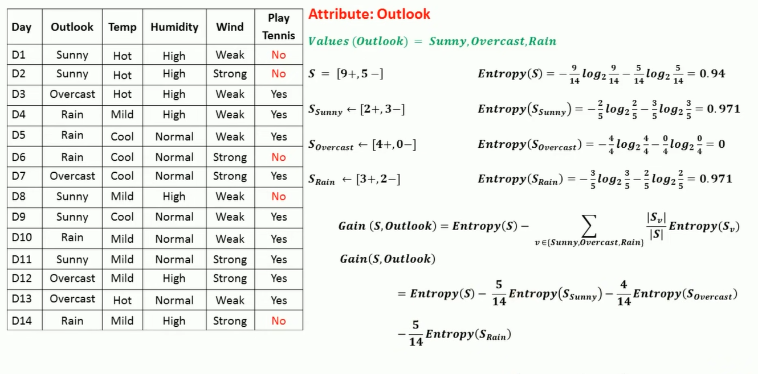
=0.02464
ID3 stands for Iterative Dichotomiser 3

Slide 10
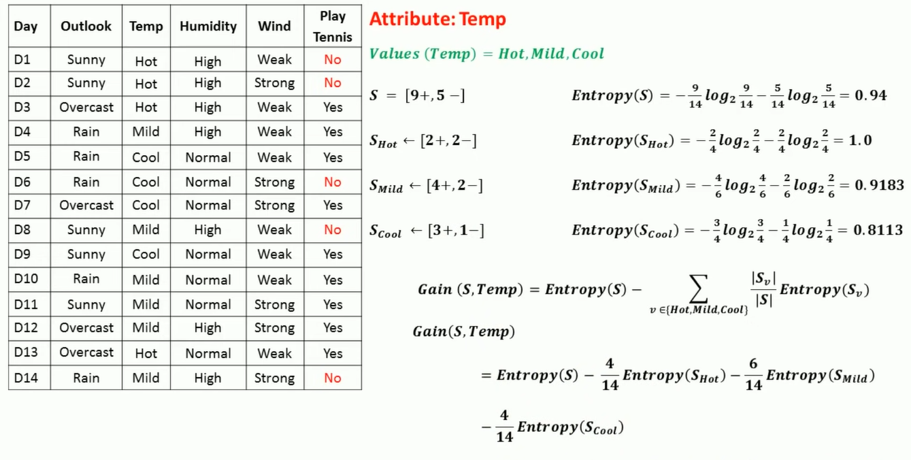
=0.0289

Slide 11
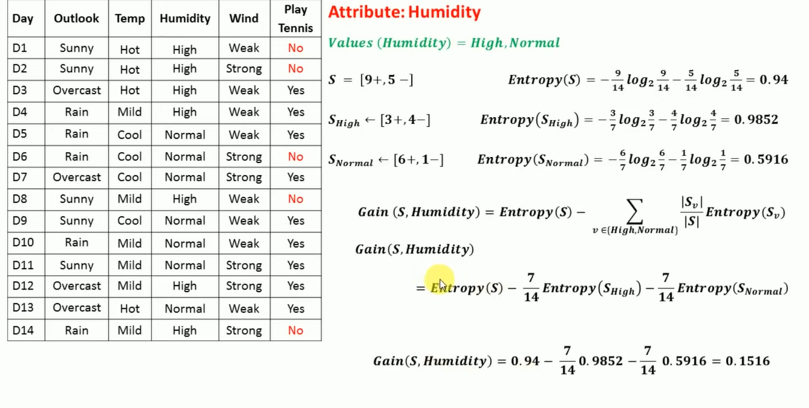

Slide 12
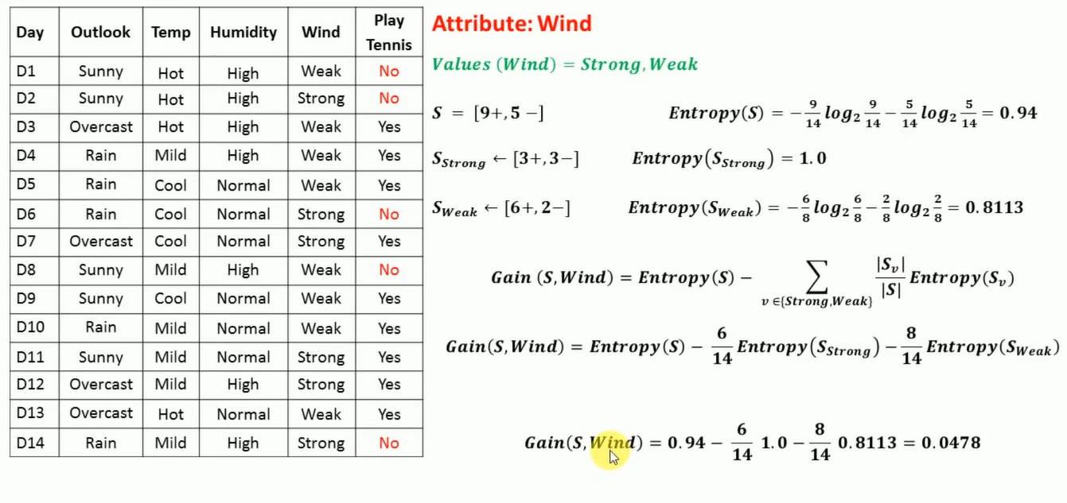

Slide 13
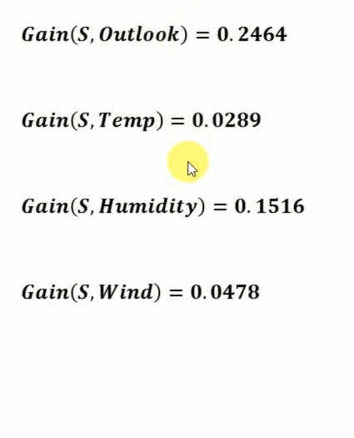

Slide 14
Day | Outlook | Temp | Humidity | Wind | Tennis?
D1 | Sunny | Hot | High | Weak | No
D2 | Sunny | Hot | High | Strong | No
D3 | Overcast | Hot | High | Weak | Yes
D4 | Rain | Mild | High | Weak | Yes
D5 | Rain | Cool | Normal | Weak | Yes
D6 | Rain | Cool | Normal | Strong | No
D7 | Overcast | Cool | Normal | Strong | Yes
D8 | Sunny | Mild | High | Weak | No
D9 | Sunny | Cool | Normal | Weak | Yes
D10 | Rain | Mild | Normal | Weak | Yes
D11 | Sunny | Mild | Normal | Strong | Yes
D12 | Overcast | Mild | High | Strong | Yes
D13 | Overcast | Hot | Normal | Weak | Yes
D14 | Rain | Mild | High | Strong | No

Slide 15
9+, 5- {D1,…,D14}
Outlook
Sunny
Overcast
Rain
{D1,D2,D8,D9,D11} 2+, 3-
{D3,D7,D12,D13} 4+, 0-
{D4,D5,D6,D10,D15} 3+, 2-
?
Yes
?

Slide 16
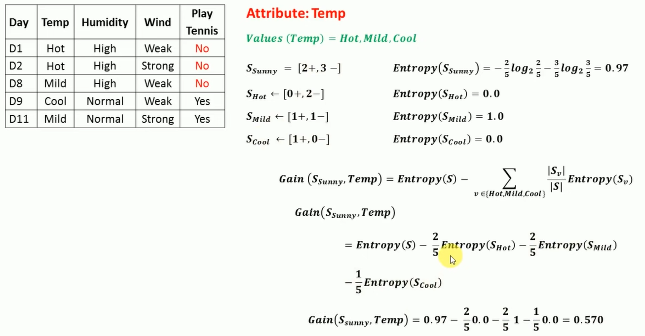

Slide 17
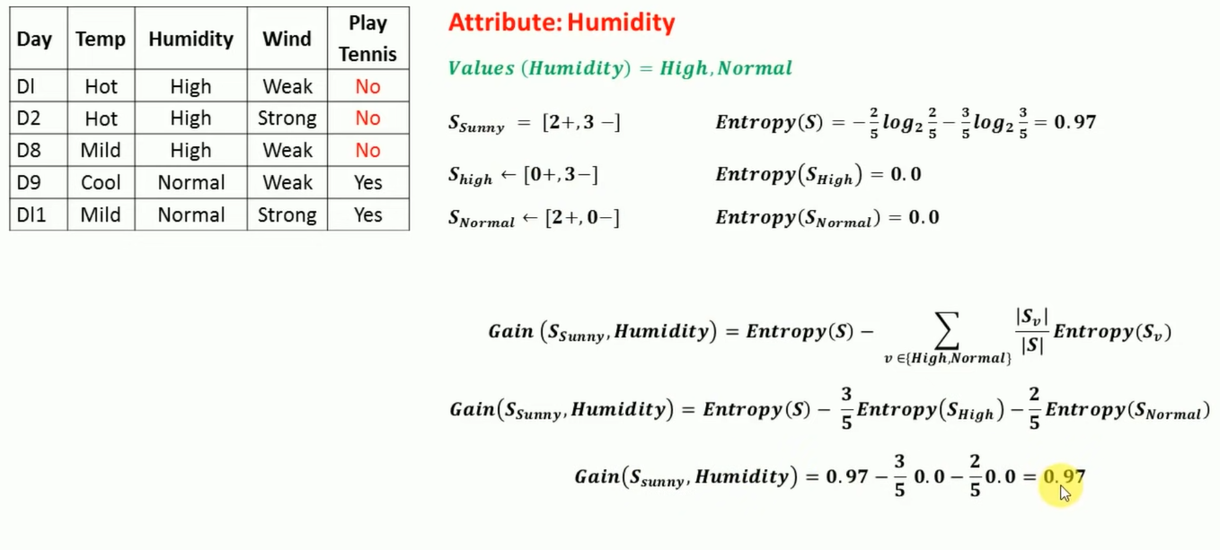

Slide 18
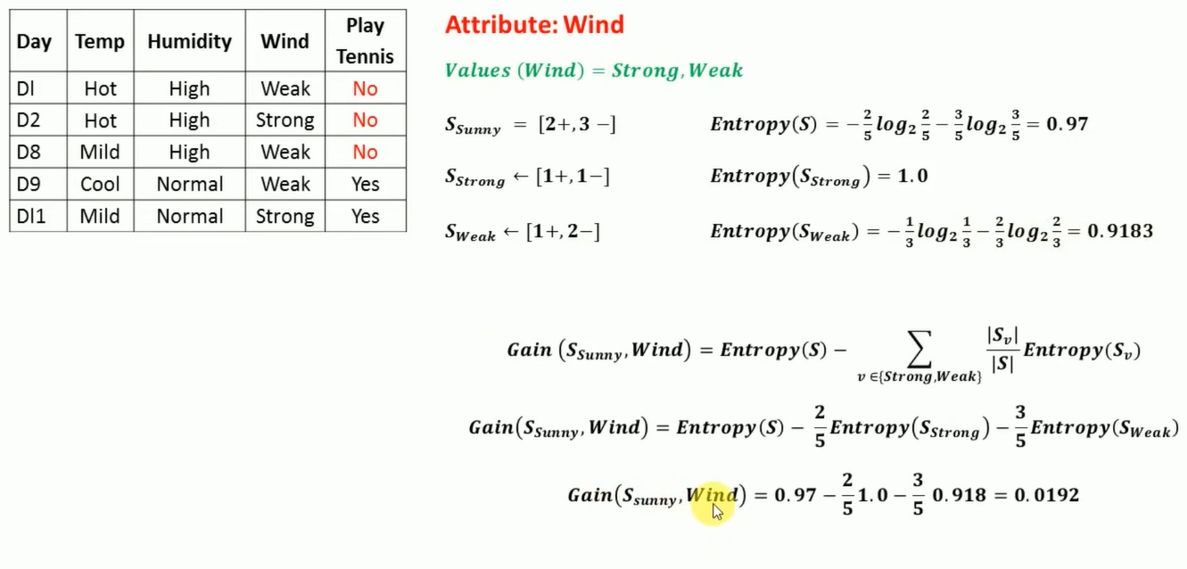

Slide 19
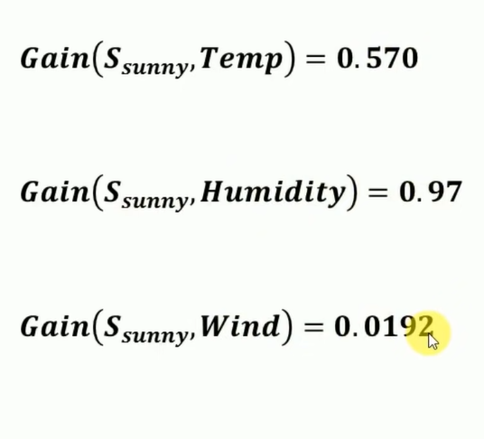

Slide 20
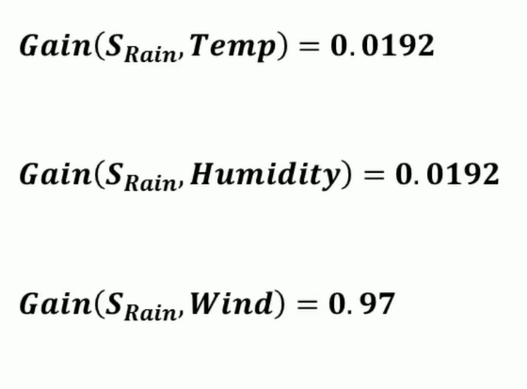

Slide 21
Outlook
Sunny
Overcast
Rain
Humidity
Yes
Wind
High
Normal
Strong
Weak
No
Yes
No
Yes

